Slide 1
Chapter 1 Fundamentals of the Analysis of Algorithm Efficiency

Slide 2

Body of Knowledge Coverage:
Basis Analysis (AL)
Basis Analysis (AL)
Asymptotic Analysis, empirical measurement.
Differences among best, average, and worst case behaviors of an algorithm.
Complexity classes, such as constant, logarithmic, linear, quadratic, and exponential.
Recurrence Relations and their solutions.
Time and space trade-offs in algorithms.

Slide 3

Introduction – What is an Algorithm?
An algorithm is a sequence of unambiguous instructions
for solving a problem, i.e.,
given any legitimate input
obtain a required output in a finite amount of time.

Slide 4

Algorithms: Efficiency, Analysis and Order
Developing efficient algorithms,
Complexity analysis of algorithms
finally, orders

Slide 5

Algorithms: Efficiency, Analysis and Order
Developing efficient algorithms,
Algorithms’ efficiency remains always an important consideration, regardless of the development of fast computers and cheap memory.
For example:
finding a name in the phone book:
a modified binary search is faster than a sequential search.
Compare algorithms for the two approaches:
show how much faster the binary search is.
Generating the Fibonacci sequence by:
a recursive or iterative algorithms, based on its definition.
Compare algorithms for the two approaches:
show how much faster the iterative way is?

Slide 6
Algorithms: Efficiency, Analysis and Order
2. Complexity analysis of algorithms
Analyze the algorithm
determining how efficiently an algorithm solves a problem.
Analyze the efficiency of an algorithm in terms of time and space.
Measure them as functions of the algorithm’s input size.
Measure time efficiency by counting the number of times the algorithm’s basic operation is executed.
Classify time complexity - worst-case, average case, and best-case efficiencies. Amortized analysis (considers both the costly and less costly operations together over the whole series of operations of the algorithm).
Measure space efficiency by counting the number of extra memory units consumed by the algorithm.
Classify space (memory) complexity....

Slide 7
Algorithms: Efficiency, Analysis and Order
3. Orders
Compute algorithm’s complexity in terms of input size n.
Determine the order of growth of the algorithm’s running time (extra memory units consumed) as its input size goes toward infinity.
Set the order of algorithms and classify the time-efficient algorithms in terms of
constant algorithms Ω(1), Ο(1), Θ(1),
linear-time algorithms Ω(n), Ο(n), Θ(n),
quadratic-time algorithms Ω(n²), Ο(n²), Θ(n²),
exponential-time algorithms Ω(2^{n}), Ο(2^{n}), Θ(2^{n}), , etc.

Slide 8
3. And finally, orders
Determine the order of growth of the algorithm’s running time (extra memory units consumed) as its input size goes toward infinity.
How bad is exponential complexity
Fibonacci example – the recursive fib cannot even compute fib(50)
Big O Complexity
c

Slide 9
Important Problem Types to be considered
The following problems illustrate the application of different:
algorithms design techniques and
methods of algorithm analysis.
Sorting,
Searching
String processing
String matching
Graph problems
Graph traversal algorithm
Shortest-path algorithm
Topological sorting
Traveling salesman problem
Numerical problems
Graph-color problem
Combinatorial problems
Graph-color problem
Geometric problems
Closet-pair problem
Convex-hull problem

Slide 10
Traveling salesman problem
Definition: A complete graph is a graph with vertices and an edge between every two vertices.
Definition: A weighted graph is a graph in which each edge is assigned a weight (representing the time, distance, or cost of traversing that edge).
Definition: A Hamiltonian path (or traceable path) is a path in an undirected or directed graph that visits each vertex exactly once.
Definition: A Hamiltonian cycle (or Hamiltonian circuit) is a Hamiltonian path that is a cycle. (NP-complete problem)
The TRAVELING SALESMAN PROBLEM (TSP): Find a Hamiltonian cycle of minimum length in a given complete weighted graph with weights which could be represented by distance from a node to another node.

Slide 11
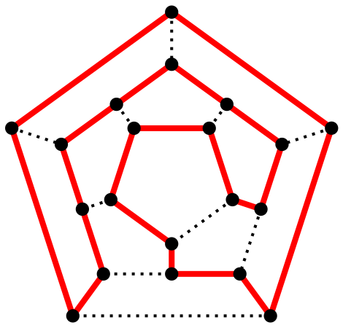
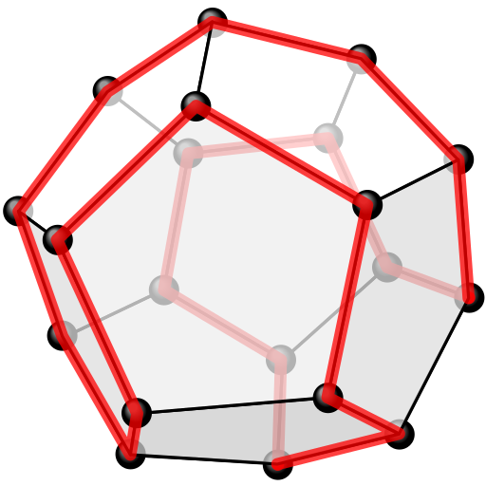
A polyhedron with twelve plane faces
Y
Y
X
X
Z
Z
B
C
A
D
D
A
C
B
One possible Hamiltonian cycle through every vertex of a dodecahedron is shown in red – like all platonic solids, the dodecahedron is Hamiltonian
The above as a two-dimensional planar graph

Slide 12

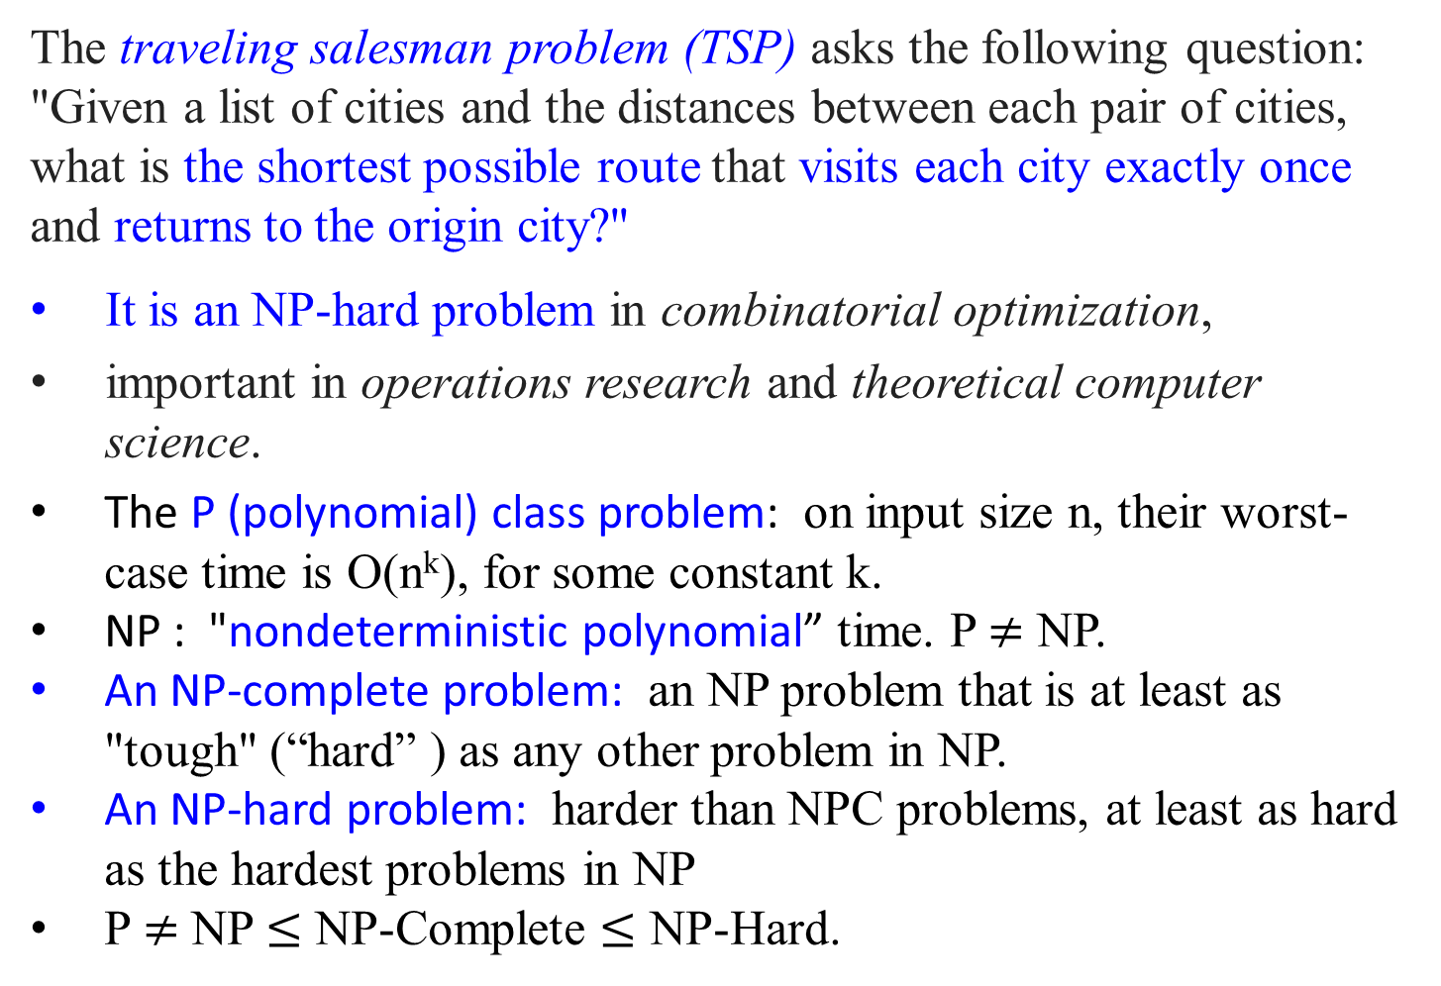
The traveling salesman problem (TSP) asks the following question: "Given a list of cities and the distances between each pair of cities, what is the shortest possible route that visits each city exactly once and returns to the origin city?"
It is an NP-hard problem in combinatorial optimization,
important in operations research and theoretical computer science.
The P (polynomial) class problem: on input size n, their worst-case time is O(n^{k}), for some constant k.
NP : "nondeterministic polynomial” time. P $≠$ NP.
An NP-complete problem: an NP problem that is at least as "tough" (“hard” ) as any other problem in NP.
An NP-hard problem: harder than NPC problems, at least as hard as the hardest problems in NP
P $≠$ NP $≤$ NP-Complete $≤$ NP-Hard.

Slide 13
Computational Complexity and Intractability
Complexity Classes
A complexity class is
the set of all of the computational problems which can be solved using a certain amount of a certain computational resource.

Slide 14

Computational Complexity and Intractability
Intractability
In computer science,
A problem is intractable if a computer has difficulty solving it.
To be more concrete,
A polynomial-time algorithm is its worst-case time complexity is bounded above by a polynomial function p(n) of its input size n. i.e., T(n) $∈$ O(p(n)).
A problem is called intractable if it is impossible to solve it with a polynomial-time algorithm.

Slide 15
Computational Complexity and Intractability
Intractability
Three general categories of problems:
Problems for which polynomial-time algorithms have been found.
Problems that have been proven to be intractable.
Problems that have not been proven to be intractable, but for which polynomial-time algorithms have never been found.

Slide 16
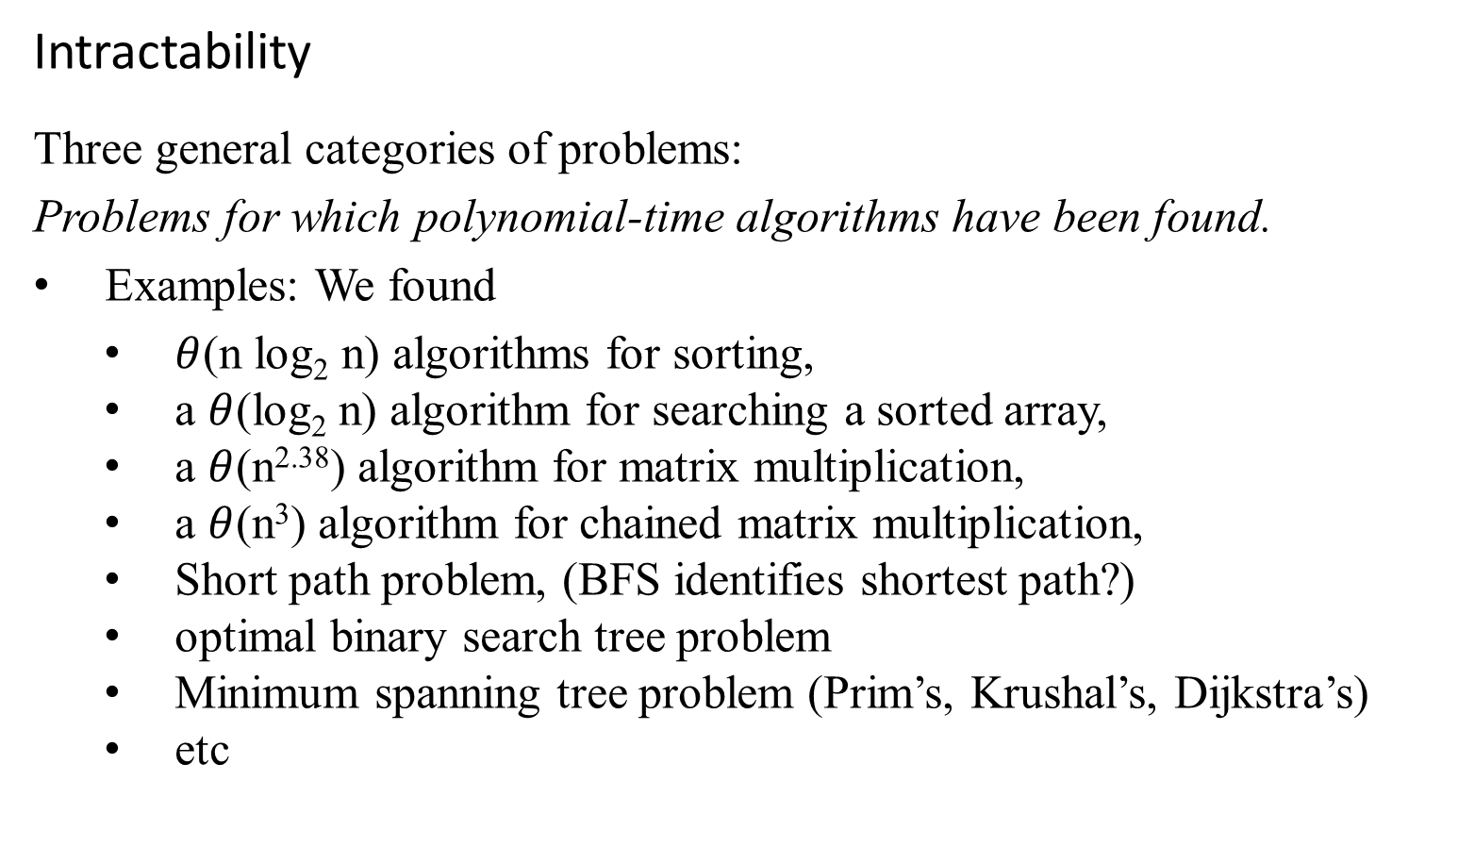
Computational Complexity and Intractability
Intractability
Three general categories of problems:
Problems for which polynomial-time algorithms have been found.
Examples: We found
$θ$(n log₂ n) algorithms for sorting,
a $θ$(log₂ n) algorithm for searching a sorted array,
a $θ$(n^{2.38}) algorithm for matrix multiplication,
a $θ$(n³) algorithm for chained matrix multiplication,
Short path problem, (BFS identifies shortest path?)
optimal binary search tree problem
Minimum spanning tree problem (Prim’s, Krushal’s, Dijkstra’s)
etc

Slide 17
Computational Complexity and Intractability
Intractability
Three general categories of problems:
Problems that have been proven to be intractable.
Examples:
Problems that require a nonpolynomial amount of output.
The problem of determining all Hamilton Circuits. (n-1)! circuits.
The Halting problem: given an algorithm and an input to the algorithm, the problem is to determine whether the algorithm will eventually halt when run with that input.
Alan Turing showed that this problem is undecidable. Turing proved no algorithm exists that always correctly decides whether, for a given arbitrary program and input, the program halts when run with that input.
Some natural decidable decision problems have been proven intractable
Does its Halt? Decidable?
input
Yes
no

Slide 18
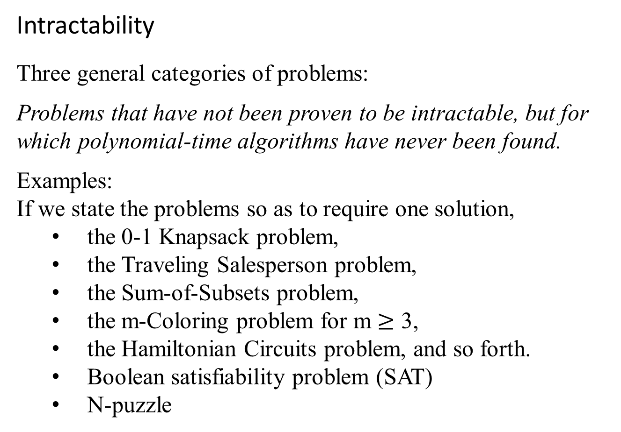
Computational Complexity and Intractability
Intractability
Three general categories of problems:
Problems that have not been proven to be intractable, but for which polynomial-time algorithms have never been found.
Examples:
If we state the problems so as to require one solution,
the 0-1 Knapsack problem,
the Traveling Salesperson problem,
the Sum-of-Subsets problem,
the m-Coloring problem for m $≥$ 3,
the Hamiltonian Circuits problem, and so forth.
Boolean satisfiability problem (SAT)
N-puzzle

Slide 19
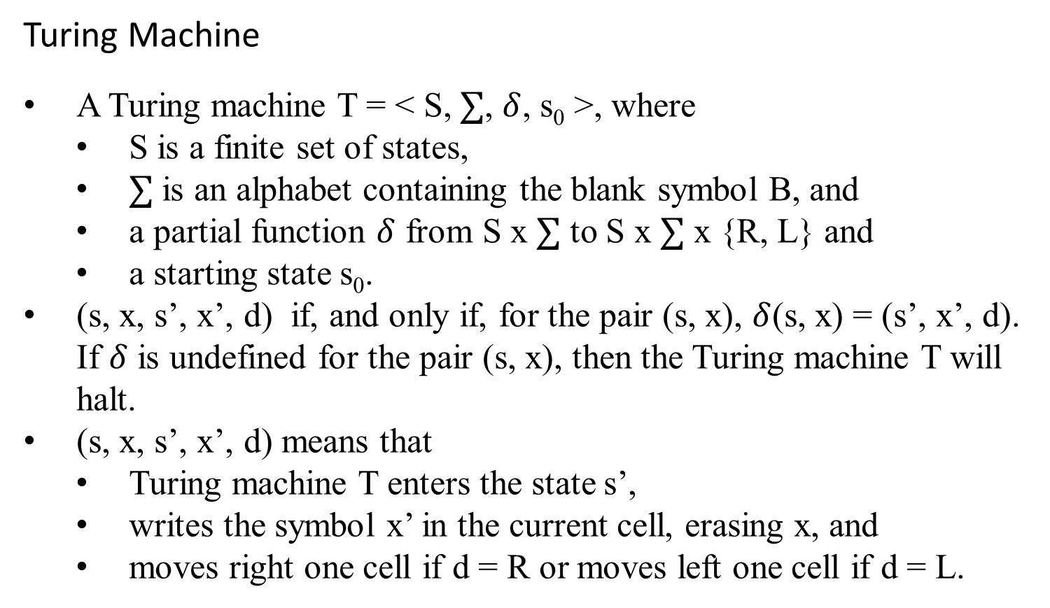
Computational Complexity and Intractability
Turing Machine
A Turing machine T = < S, $∑$, $δ$, s₀ >, where
S is a finite set of states,
$∑$ is an alphabet containing the blank symbol B, and
a partial function $δ$ from S x $∑$ to S x $∑$ x {R, L} and
a starting state s₀.
(s, x, s’, x’, d) if, and only if, for the pair (s, x), $δ$(s, x) = (s’, x’, d). If $δ$ is undefined for the pair (s, x), then the Turing machine T will halt.
(s, x, s’, x’, d) means that
Turing machine T enters the state s’,
writes the symbol x’ in the current cell, erasing x, and
moves right one cell if d = R or moves left one cell if d = L.

Slide 20
Turing Machine
Example:
What is the final tape when the Turing machine T defined by the seven five-tuples
(s₀, 0, s₀, 0, R),
(s₀, 1, s₁, 1, R),
(s₀, B, s₃, B, R),
(s₁, 0, s₀, 0, R),
(s₁, 1, s₂, 0, L),
(s₁, B, s₃, B, R),
(s₂, 1, s₃, 0, R)
is run on the tape shown in the following figure?
0/0/R
s₀
1/1/R
s₁
0/0/R
0/0/R
B/B/R
1/1/R
1/0/L
B/B/R
B/B/R
s₃
s₂
1/0/R

Slide 21
s₀
ReadWrite Head at initial position
… | B | B | 0 | 1 | 0 | 1 | 1 | 0 | B | B | …
(s₀, 0, s₀, 0, R),
(s₀, 1, s₁, 1, R),
(s₀, B, s₃, B, R),
(s₁, 0, s₀, 0, R),
(s₁, 1, s₂, 0, L),
(s₁, B, s₃, B, R),
(s₂, 1, s₃, 0, R)
Erase the first
11 to 00 only.
Add:
(s₃, B, s₃, B, R)
(s₃, 0, s₀, 0, R)
(s₃, 1, s₁, 1, R)
Erase all the even pairs of 1s to 0 between B’s only
s₀
… | B | B | 0 | 1 | 0 | 1 | 1 | 0 | B | B | …
s₁
… | B | B | 0 | 1 | 0 | 1 | 1 | 0 | B | B | …
s₀
… | B | B | 0 | 1 | 0 | 1 | 1 | 0 | B | B | …
s₁
… | B | B | 0 | 1 | 0 | 1 | 1 | 0 | B | B | …
s₂
… | B | B | 0 | 1 | 0 | 1 | 0 | 0 | B | B | …
s₃
… | B | B | 0 | 1 | 0 | 0 | 0 | 0 | B | B | …
Figure: The steps produced by running T on the tape.
Machine Halts

Slide 22
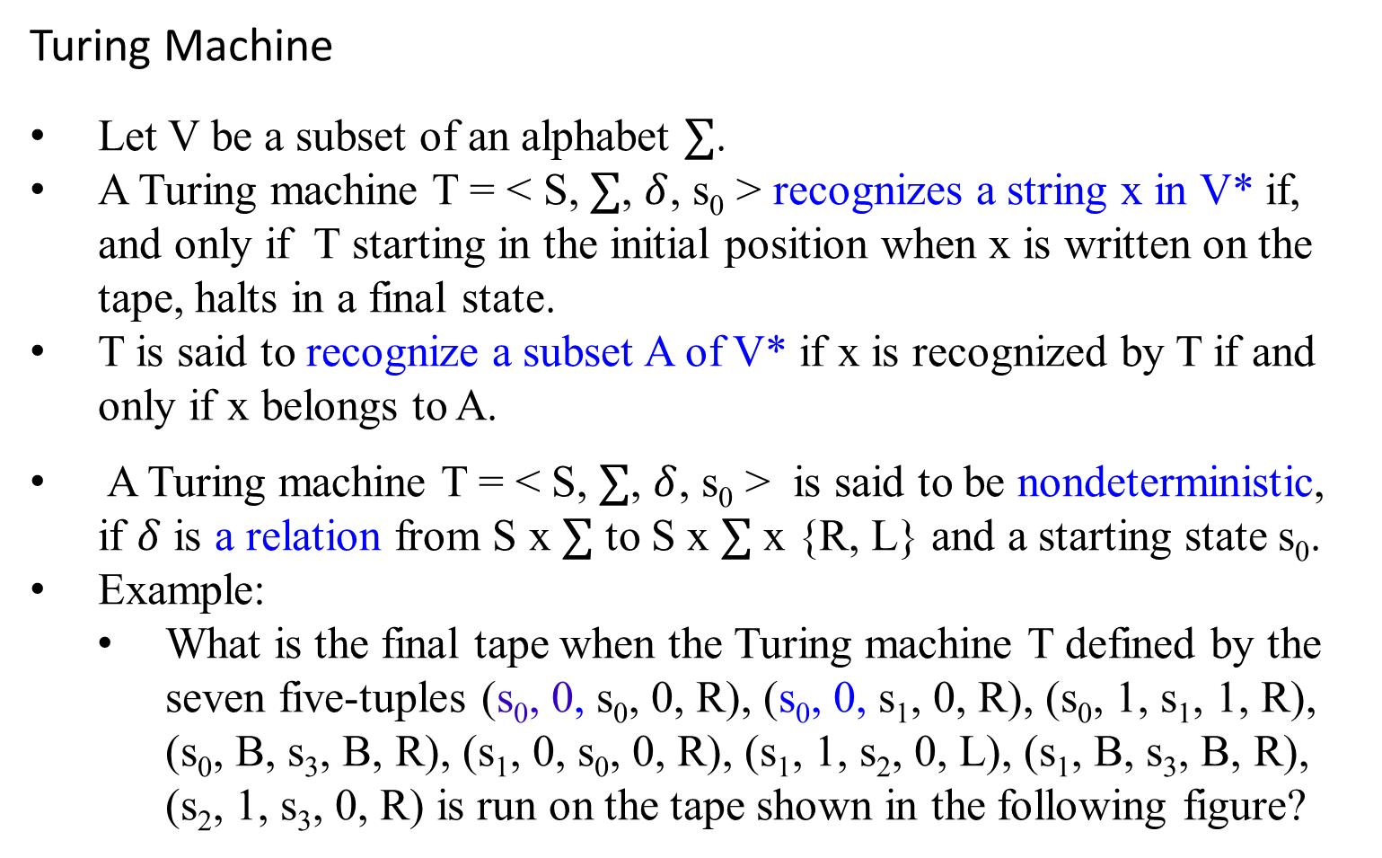
Turing Machine
Let V be a subset of an alphabet $∑$.
A Turing machine T = < S, $∑$, $δ$, s₀ > recognizes a string x in V* if, and only if T starting in the initial position when x is written on the tape, halts in a final state.
T is said to recognize a subset A of V* if x is recognized by T if and only if x belongs to A.
A Turing machine T = < S, $∑$, $δ$, s₀ > is said to be nondeterministic, if $δ$ is a relation from S x $∑$ to S x $∑$ x {R, L} and a starting state s₀.
Example:
What is the final tape when the Turing machine T defined by the seven five-tuples (s₀, 0, s₀, 0, R), (s₀, 0, s₁, 0, R), (s₀, 1, s₁, 1, R), (s₀, B, s₃, B, R), (s₁, 0, s₀, 0, R), (s₁, 1, s₂, 0, L), (s₁, B, s₃, B, R), (s₂, 1, s₃, 0, R) is run on the tape shown in the following figure?

Slide 23
Computational Complexity and Intractability
Turing Machine
Use this model to make precise some of the notions concerning computational complexity.
A decision problem, known yes-or-no problem, asks whether statements from a particular class of statements are true.
The halting problem is the decision problem that asks whether a Turing machine T eventually halts when given an input string x.
The halting problem is an unsolvable decision problem.
Given an encoding of a Turing machine T and its input string x as input, no Turing machine exists that can determine whether T eventually halts when starts with x written on its tape.

Slide 24
The P class problem:
The complexity class P consists of problems that
each problem can be solved in polynomial time O(n^{k}) for some constant k, where n is the input’s size to the problem.
A problem is in the complexity class P
if it is a decision problem and there exists an algorithm that solves any instance of input size n in time O(n^{k}), for some integer k.
Equivalently, the complexity class P contains all decision problems that can be solved by a deterministic Turing machine using a polynomial amount of computation time, or polynomial time.
P is known to contain many natural problems, including the decision versions of linear programming, computing GCD, and finding a maximum matching.

Slide 25
Computational Complexity and Intractability
The P class problem:
A language L is in P if and only if there exists a deterministic Turing machine M, such that
M runs for polynomial time on all inputs,
for all x in L, M outputs 1, and
for all x not in L, M outputs 0.
Cobham’s thesis holds that P is the class of computational problems that are "efficiently solvable" or “tractable”;
in practice, some problems not known to be in P have practical solutions, and some that are in P do not.
asserts that computational problems can be feasibly computed on some computational device only if they can be computed in polynomial time (that is, if they are in the complexity class P).
TM(01011) yields 1.
TM(11) yields 0

Slide 26
Computational Complexity and Intractability
In Computational complexity theory
A decision problem is in the complexity class NP, (the class of nondeterministric polynomial time problems),
if the set of decision problems for which the problem instances, where the answer is “yes”, have proofs verifiable in polynomial time by a deterministic Turing machine.
Equivalently,
if the set of decision problems that can be solved in polynomial time by a nondeterministic Turing machine.
A P-problem (whose solution time is bounded by a polynomial) is always also NP.

Slide 27
Computational Complexity and Intractability
In Computational complexity theory
The abbreviation NP; "nondeterministic, polynomial time."
These two definitions are equivalent because the algorithm based on the Turing machine consists of two phases:
the first phase consists of a guess about the solution, which is generated in a non-deterministic way, and
the second phase consists of a deterministic algorithm that verifies if the guess is a solution to the problem

Slide 28
Computational Complexity and Intractability
In Computational complexity theory
Problems in P are called tractable, whereas problems not in P are called intractable.
For a problem to be in P, a deterministic Turing machine must exist that can decide in polynomial time whether a particular statement of the class addressed by the decision problem is true.
Example:
Determining whether an item is in a list of n elements is a tractable problem.

Slide 29
Computational Complexity and Intractability
In Computational complexity theory
For a problem to be in NP, it is necessary only that there be a nondeterministic Turing machine that, when given a true statement from the set of statements addressed by the problem, can verify its truth in polynomial time by making the correct guess at each step from the set of allowable steps corresponding to the current state and tape symbol.
Example:
The problem of determining whether a given graph has a Hamilton circuit is an NP problem, because
a nondeterministic Turing machine can easily verify that a simple circuit in a graph passes through each vertex exactly once.

Slide 30
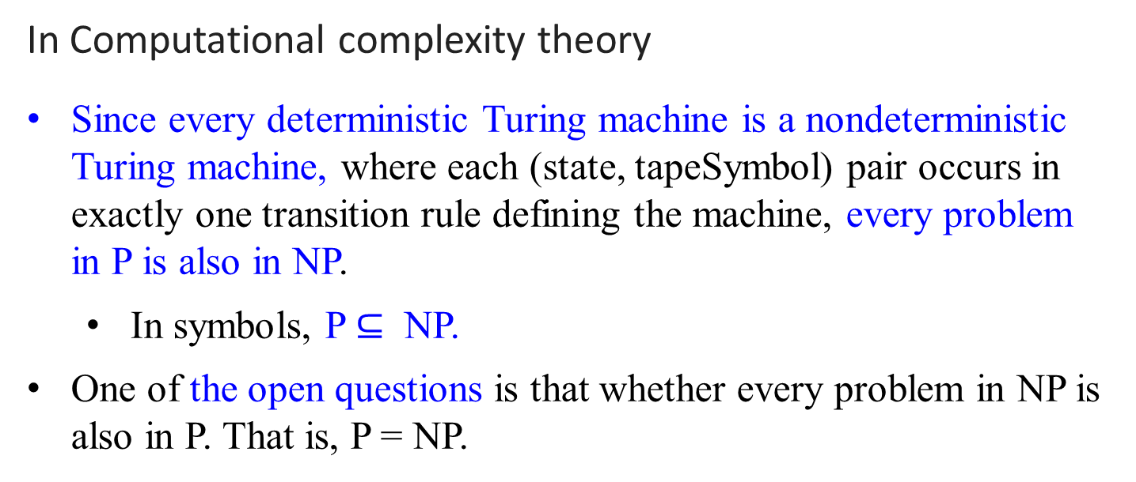
Computational Complexity and Intractability
In Computational complexity theory
Since every deterministic Turing machine is a nondeterministic Turing machine, where each (state, tapeSymbol) pair occurs in exactly one transition rule defining the machine, every problem in P is also in NP.
In symbols, P $⊆$ NP.
One of the open questions is that whether every problem in NP is also in P. That is, P = NP.

Slide 31
Computational Complexity and Intractability
In Computational complexity theory
A P-problem (which can be solved in polynomial time) is always a NP-problem.
For a NP-problem and a solution to the problem that is somehow known, then demonstrating the correctness of the solution can always be reduced to a single P (polynomial time) verification.
If P and NP are not equivalent, then the solution of NP-problems requires (in the worst case) an exhaustive search.

Slide 32
NP problems
Graph theory has these fascinating(annoying?) pairs of problems
Shortest path algorithms?
Longest path is NP complete (will define NP complete later)
Eulerian tours (visit every vertex but cover every edge only once, even degree, etc). Solvable in polynomial time P!
Hamiltonian tours (visit every vertex, no vertices can be repeated). NP complete

Slide 33
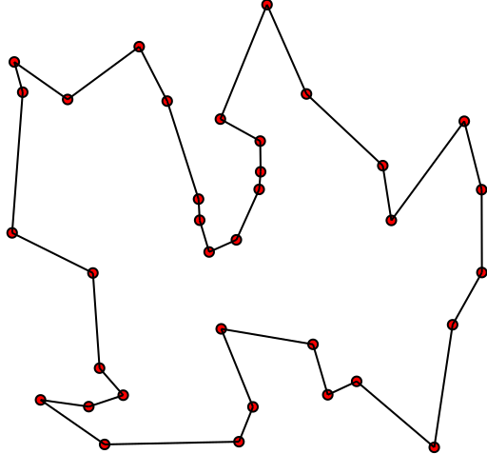

Travelling salesman problem
Solution of a travelling salesman problem: the black line shows the shortest possible loop that connects every dot

Slide 34

What is the complexity of primality testing?
This loops until the square root of n.
So this should be O($\sqrt{n}$ ), which is not a polynomial time, but is exponential time.
What is the input size?
How many bits does it take to
represent the number n?
log(n) = k bits
What is $\sqrt{n}?$
Since log₂ n = log₂ n *log₂ 2
= $\log_{2}{2^{\text{log}\text{2} \text{n}}}$
n = $2^{\log_{2}{n}}$
$O(\sqrt{n })=O(\sqrt{2^{\log\left(n\right)}} )$= O((${2^{\log_{2}{n}})}^{\frac{1}{2}}$)
Naïve primality testing is exponential!!
public static boolean isPrime(int n){
boolean answer = (n>1)? true: false;
for(int i = 2; i*i <= n; ++i)
{
System.out.printf("%d\n", i);
if(n%i == 0)
{
answer = false;
break;
}
}
return answer;
}

Slide 35
Why obsess about primes?
Cryptography uses it heavily
Primality testing actually is in P
Proven in 2002
Uses complicated number theory
Also known as primality test

Slide 36
The complexity class NP
NP is not the same as non-polynomial complexity/running time. NP does not stand for not polynomial.
NP stands for Non-Deterministic polynomial time
NP means verifiable in polynomial time
Verifiable?
If we are somehow given a ‘certificate’ of a solution we can verify the legitimacy in polynomial time

Slide 37
P = the set of problems that are solvable in polynomial time by a Deterministic Turing Machine.
NP = the set of decision problems(answer is either yes or no) that are solvable in nondeterministic polynomial time; i.e., can be solved in polynomial time by a Nondeterministic Turing Machine.

Slide 38
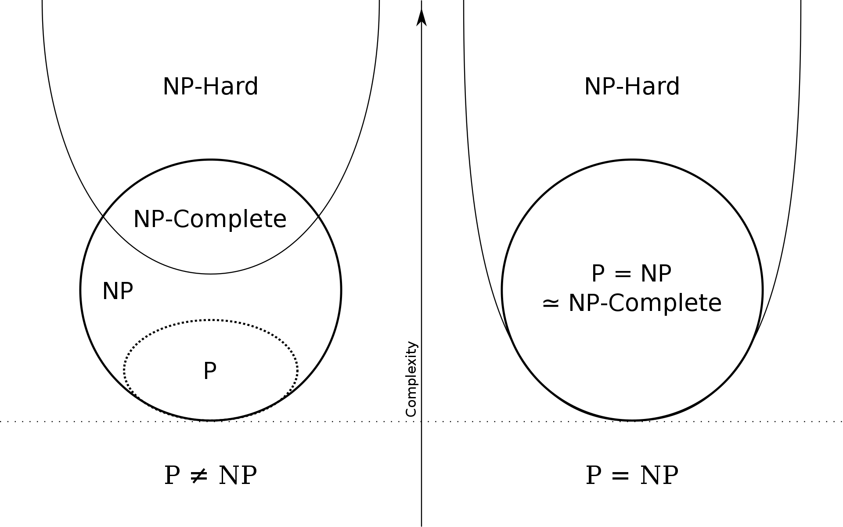
Euler diagram for P, NP, NP-complete, and NP-hard set of problems (excluding the empty language and its complement, which belong to P but are not NP-complete)

Slide 39
Formal Proof of Program Correctness
Using Axiomatic Semantics

Slide 40
To be continued

